Slide 1
Lead Score Case Study
Submitted by :
Racherla Hemanth Raj

Slide 2
Lead Score Case Study for X Education
Problem Statement :
X Education sells online courses to industry professionals. The company markets its courses on several websites and search engines like Google.
Once these people land on the website, they might browse the courses or fill up a form for the course or watch some videos. When these people fill up a form providing their email address or phone number, they are classified to be a lead. Moreover, the company also gets leads through past referrals.
Once these leads are acquired, employees from the sales team start making calls, writing emails, etc. Through this process, some of the leads get converted while most do not. The typical lead conversion rate at X education is around 30%.
Business Goal:
X Education needs help in selecting the most promising leads, i.e. the leads that are most likely to convert into paying customers.
The company needs a model wherein you a lead score is assigned to each of the leads such that the customers with higher lead score have a higher conversion chance and the customers with lower lead score have a lower conversion chance.
The CEO, in particular, has given a ballpark of the target lead conversion rate to be around 80%.

Slide 3
Problem Approach
Sourcing the data for analysis
1. Data has been provided for us in csv format
Clean and prepare the data
1. Some columns have values Select which are missing data so we convert them into null values
2 .Checked for the null values and remove columns having missing values greater than 40
3. Imputation is done for values and null values is removed from data
Exploratory Data Analysis.
1. Univariate and Bivariate analysis on dataset
Feature Scaling
1.Dummy value creation and Scaling is done
Splitting the data into Test and Train dataset.
1. Data is divided with 80 percent as Training data and remaining test data
Build a logistic Regression model and calculate Lead Score.
Evaluating the model by using different metrics - Specificity and Sensitivity or Precision and Recall.
Applying the best model in Test data based on the Sensitivity and Specificity Metrics.

Slide 4
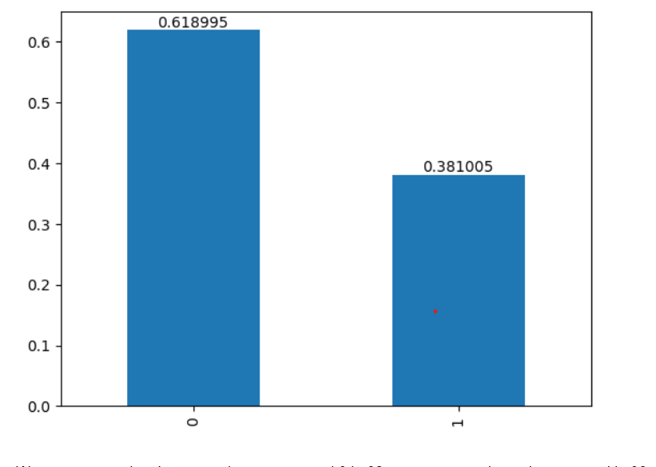
Conversion rate
Our Conversion rate is nearly 39 percentage

Slide 5
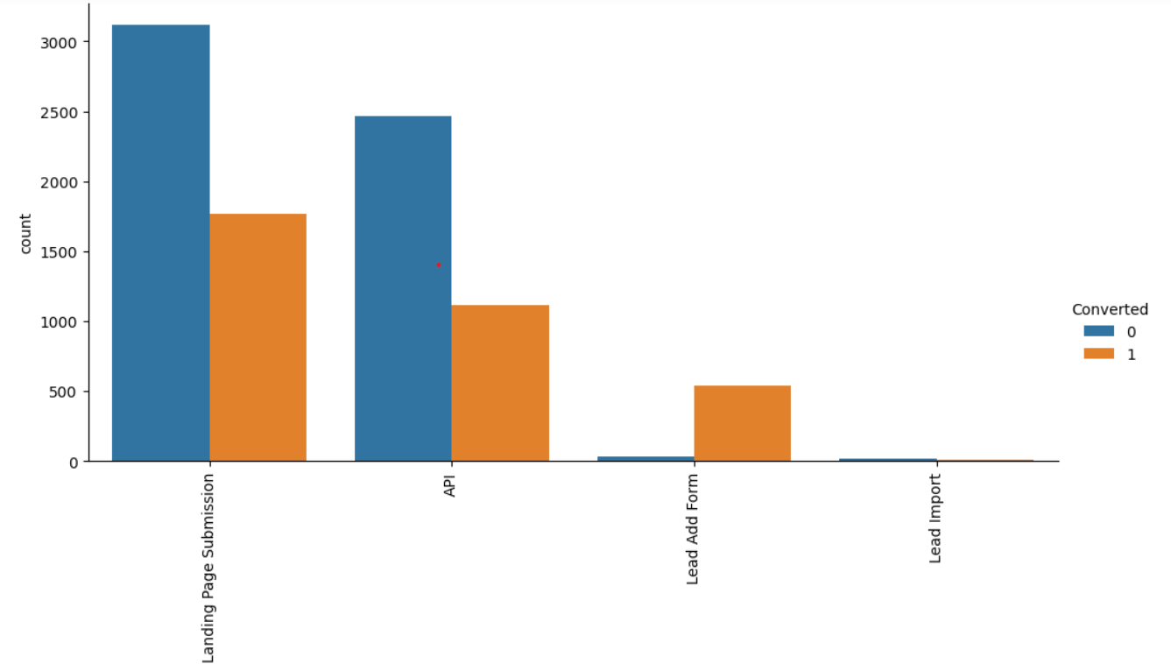
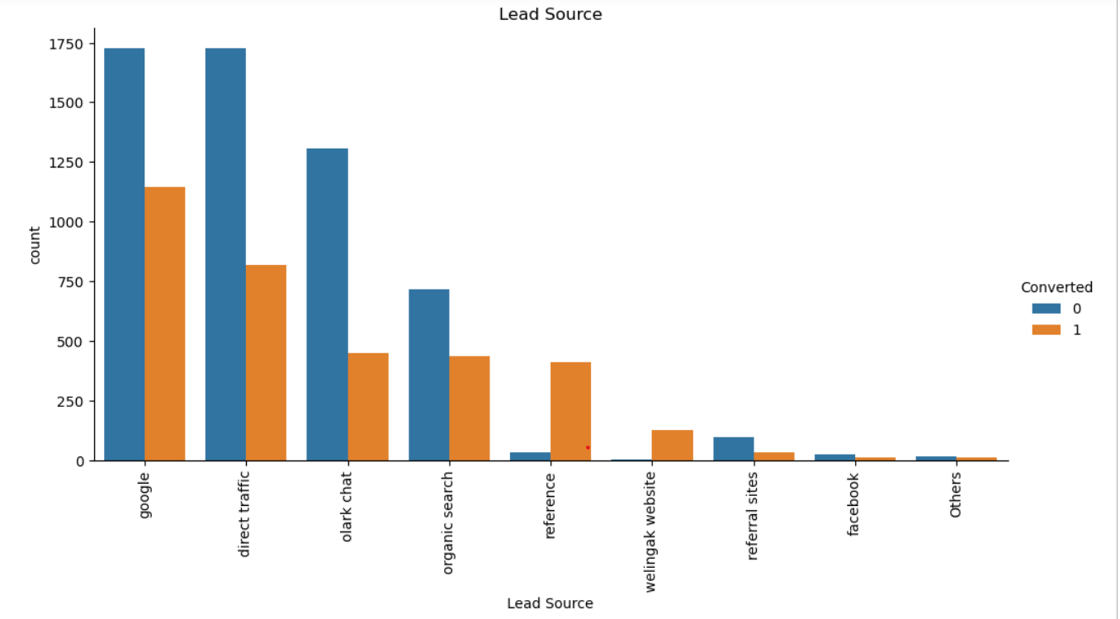
EDA on Data set
The Data set is first plotted on Categorical variables and some of the significant fields are lead source and origin
.
Lead Add form and reference wellingak website have good conversions

Slide 6
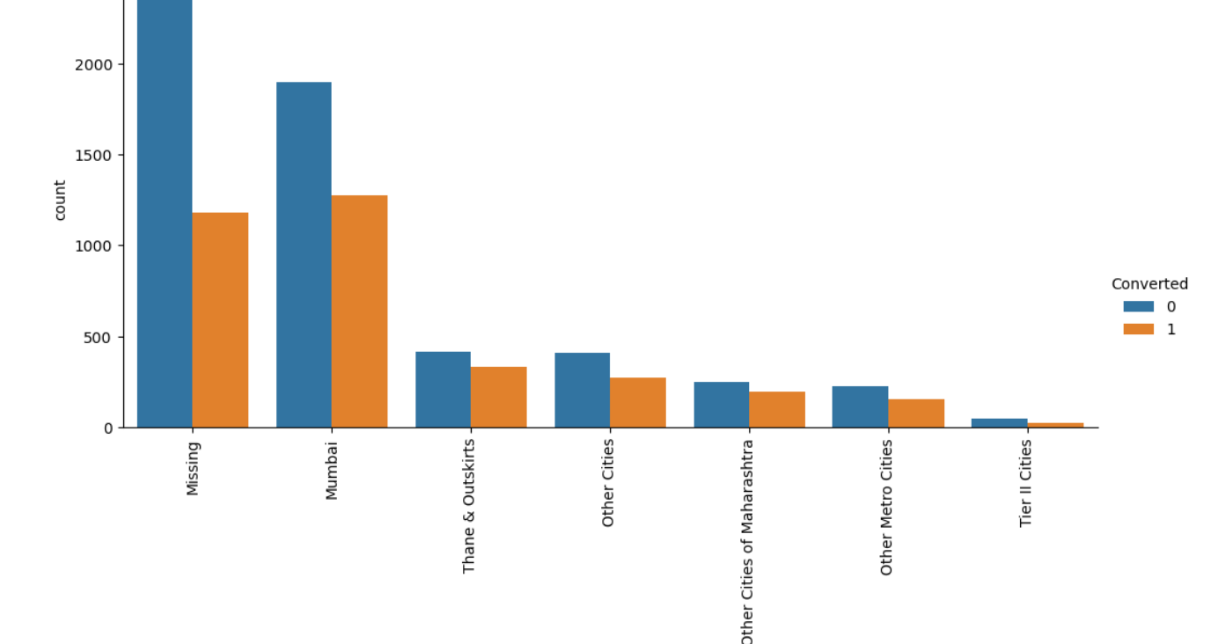
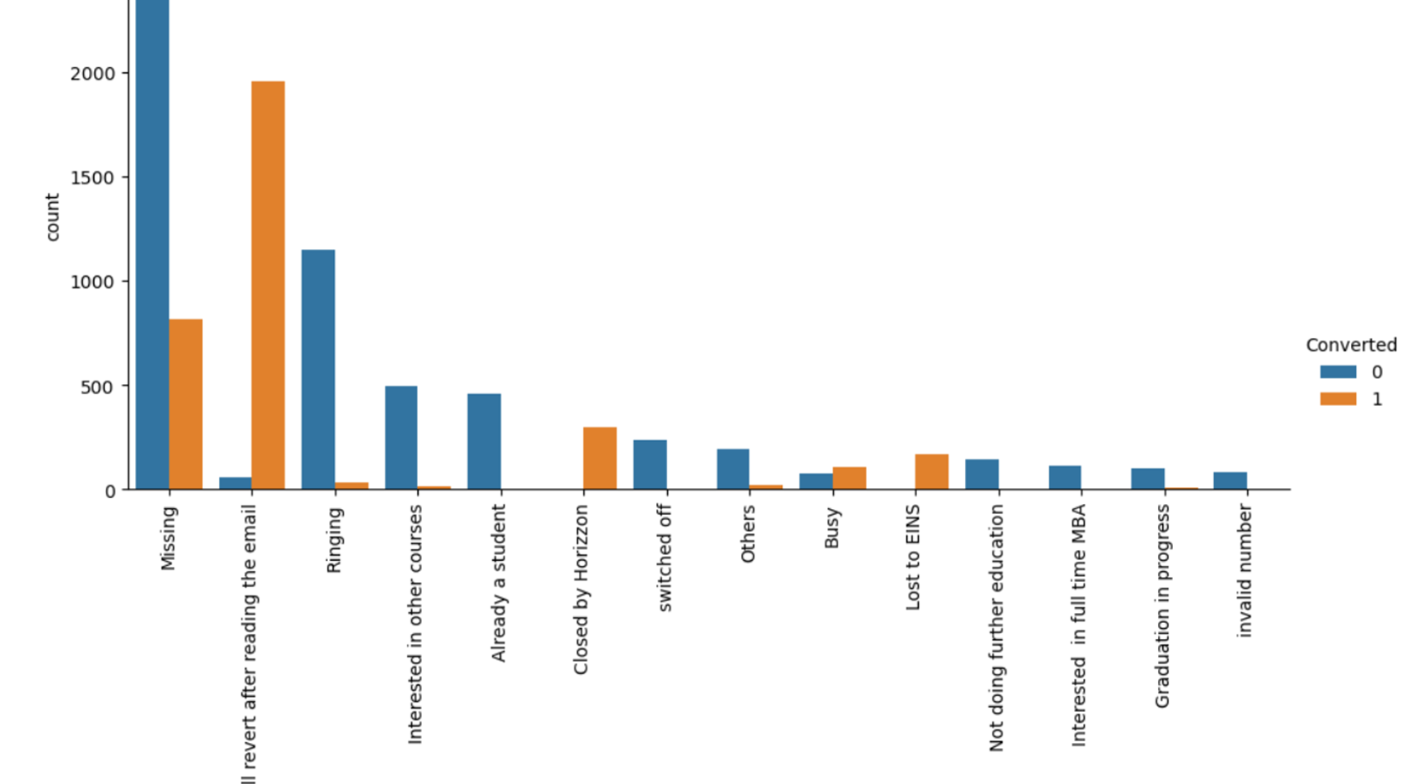
Mumbai is the major city for leads followed by other cities
Major leads are reverting and closed by horizon tags

Slide 7
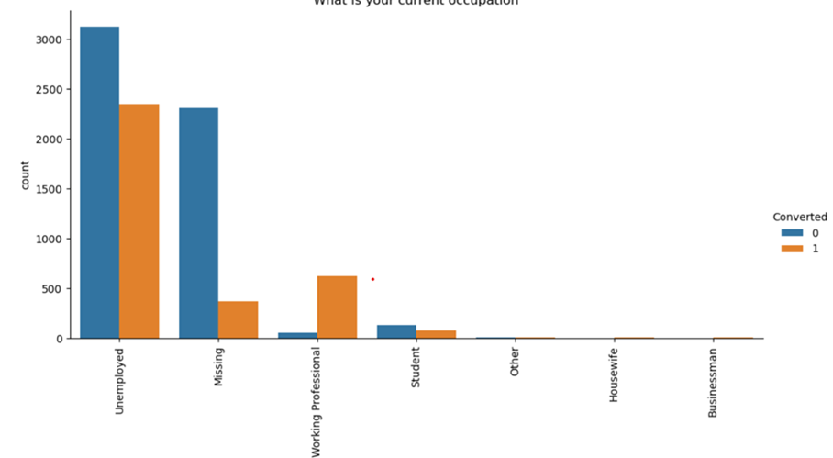
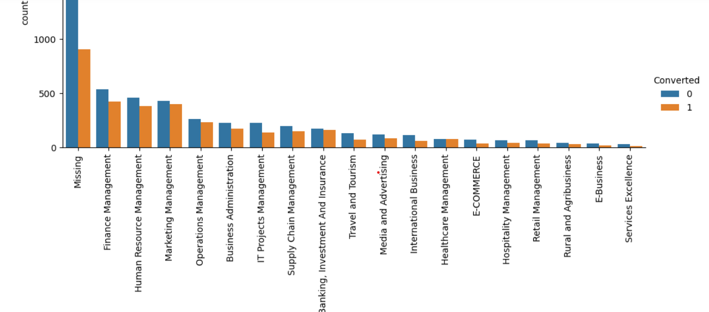
Unemployed and Working Professionals are major leads for us
Leads are more from Management posts with Finance Management has highest
.

Slide 8
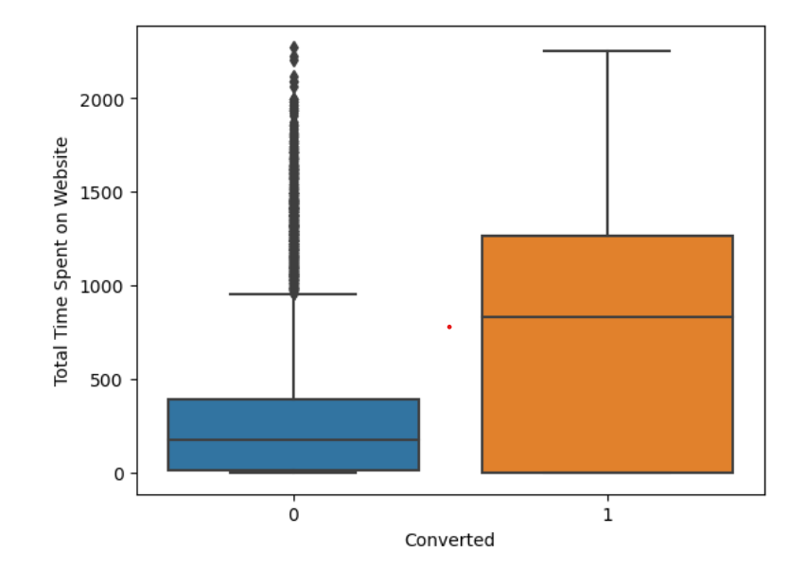
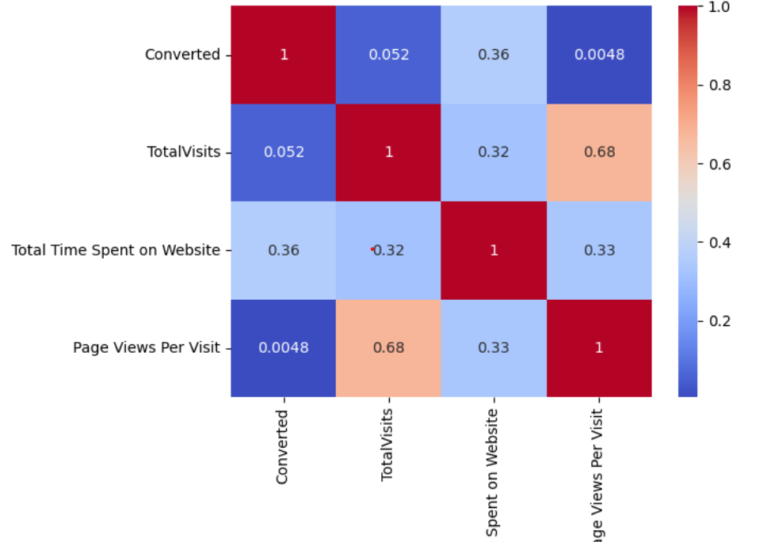
People spending average of 750-770 are more likely to convert leads
Most of our numeric values are not correlated to each other
.

Slide 9
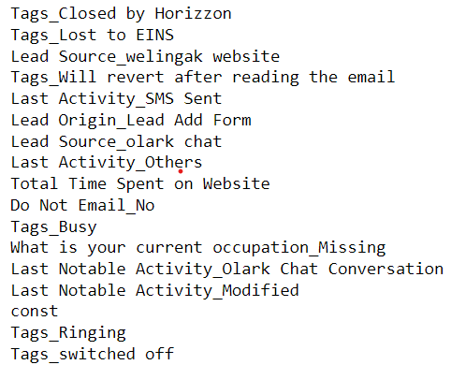
The Variables influencing our model

Slide 10
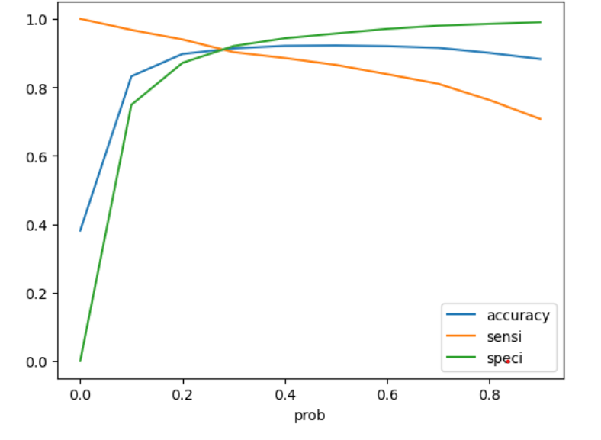
Sensitivity and Specificity on Train Data Set
From graph optimal cut off of 0.34 based on Accuracy,
Sensitivity and Specificity
3161 697
Accuracy - 92%
Sensitivity - 90 %
Specificity - 82 %
False Positive Rate – 7.6%
Positive Predictive Value – 87%

Slide 11
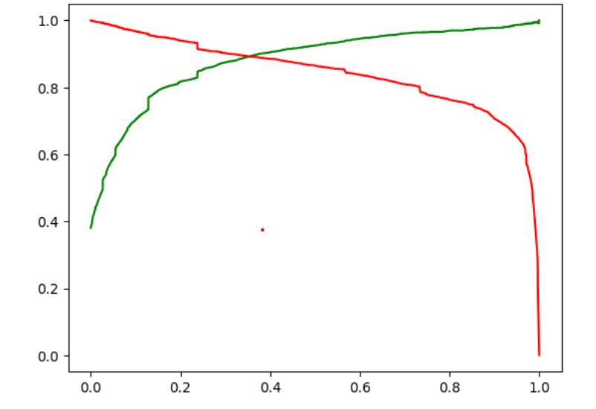
Model Evaluation- Precision and Recall on Train Dataset
3397 461
From graph an optimal cut off of 0.34 based on Precision and
Recall
Precision for converted - 89 %
Recall for converted- 89 %

Slide 12
Model Evaluation – Sensitivity and Specificity on Test Dataset
1394 300
Accuracy - 93 %
Sensitivity - 92 %
Specificity - 93 %

Slide 13
Conclusion
While we have checked both Sensitivity-Specificity as well as Precision and Recall Metrics, we have considered the optimal cut off based on Sensitivity and Specificity for calculating the final prediction.
Accuracy, Sensitivity and Specificity values of test set are around 93%, 92% and 93% which are approximately closer to the respective values calculated using trained set.
Also the lead score calculated in the trained set of data shows the conversion rate on the final predicted model is around 93%
Hence overall this model seems to be good

